Slide 1
Github Repository
AAM08C Computer Literacy through Coding

Slide 2
Use Chrome throughout

Slide 3
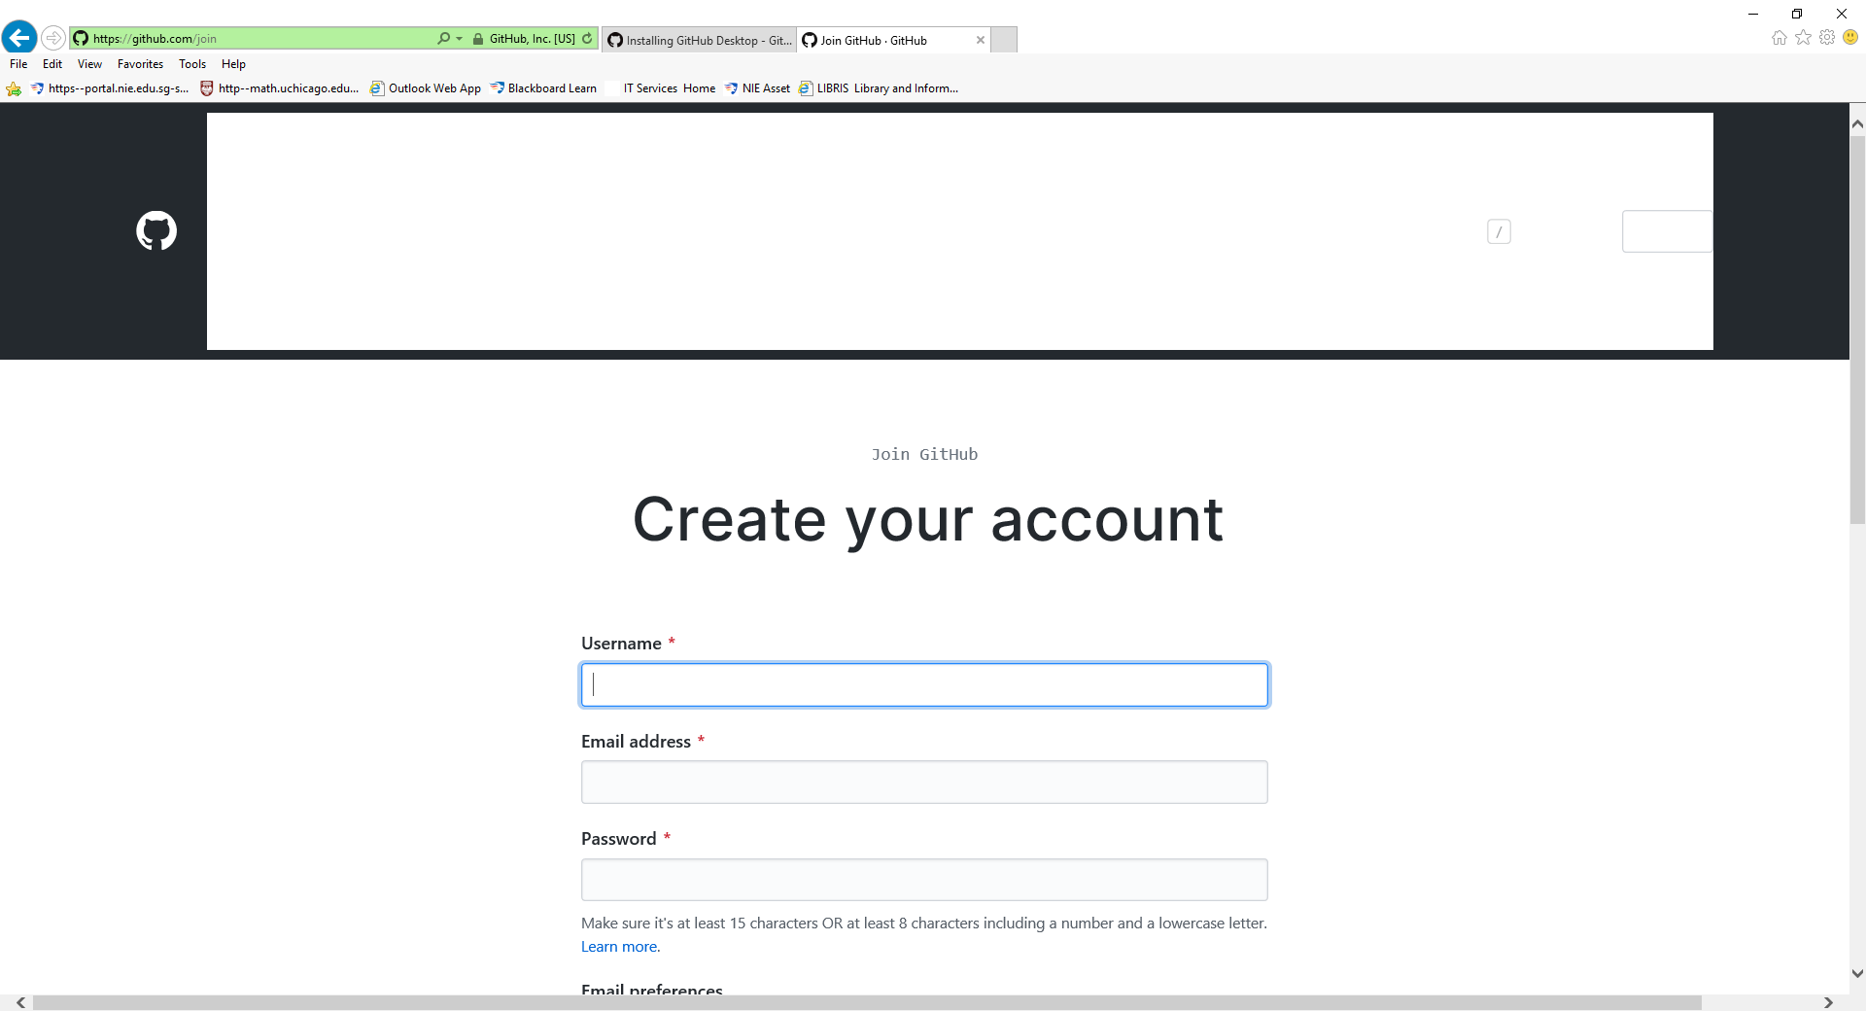
Github account

Slide 4
Download Github Desktop
Google for Github Desktop:
https://help.github.com/en/desktop/getting-started-with-github-desktop/installing-github-desktop

Slide 5
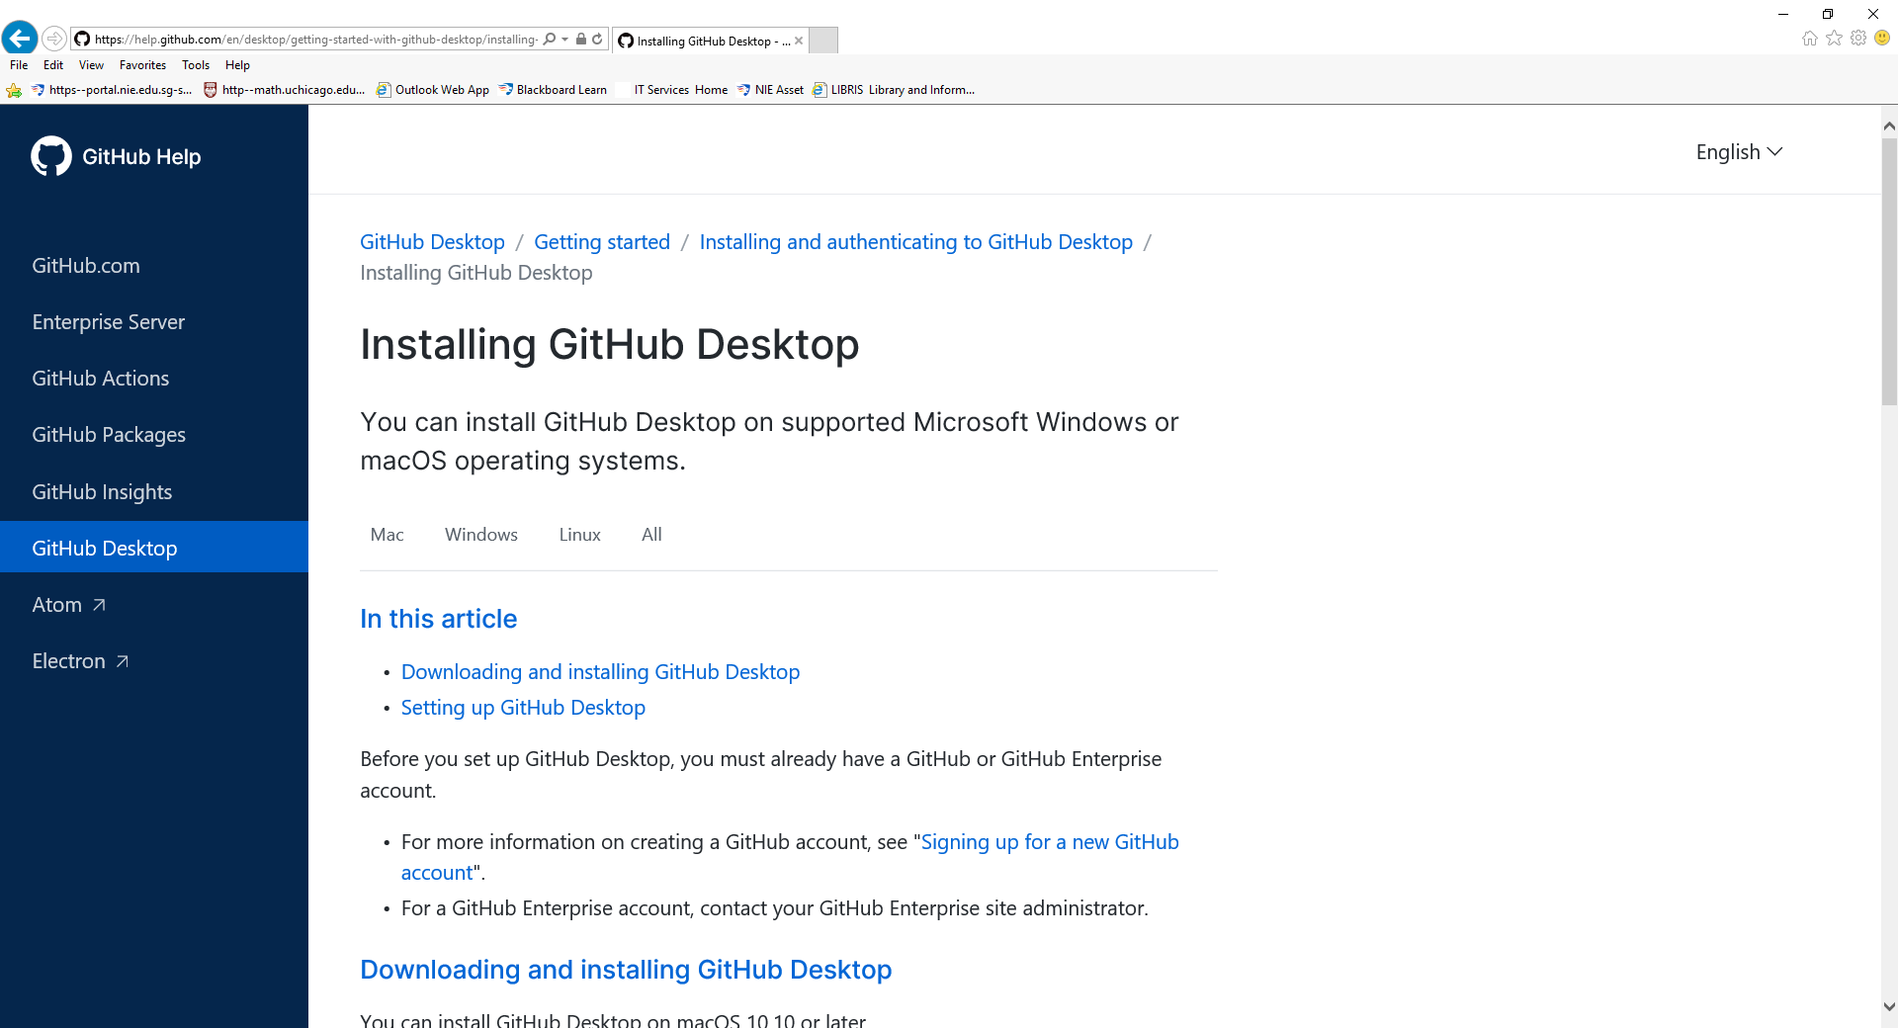
Github Desktop

Slide 6
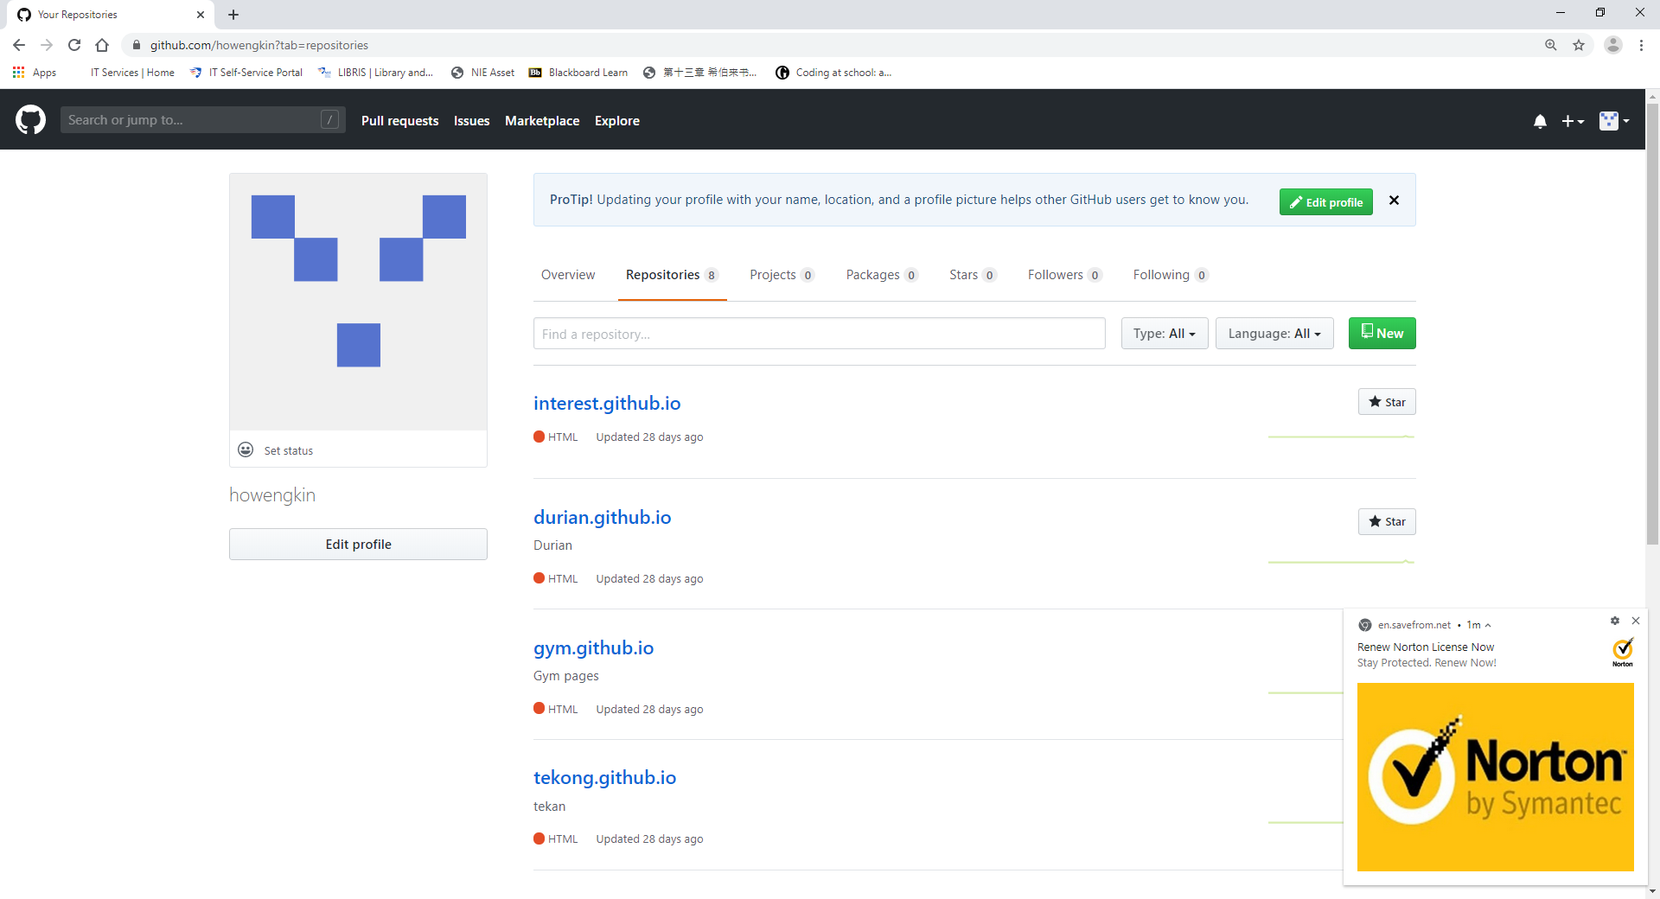
Github Repository

Slide 7
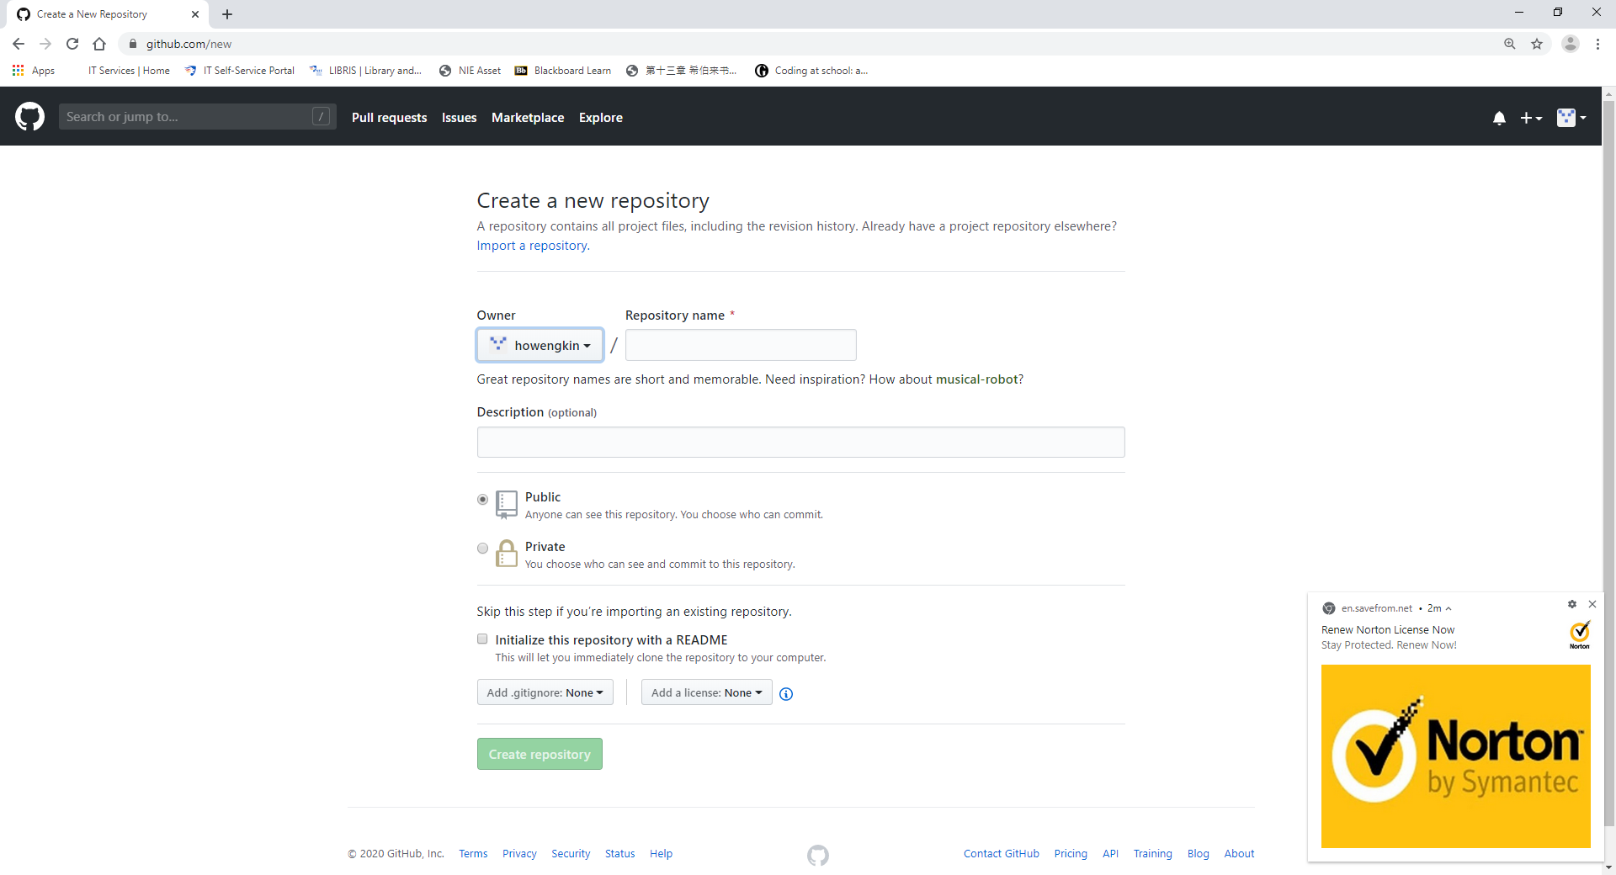
New Repository: select “Public”

Slide 8
New Repository
Name your new repository using the format:
xxx.github.io
Note that the “.io” extension is very important; and no special characters and no uppercase allowed in the name “xxx”.
Click: Create Repository

Slide 9
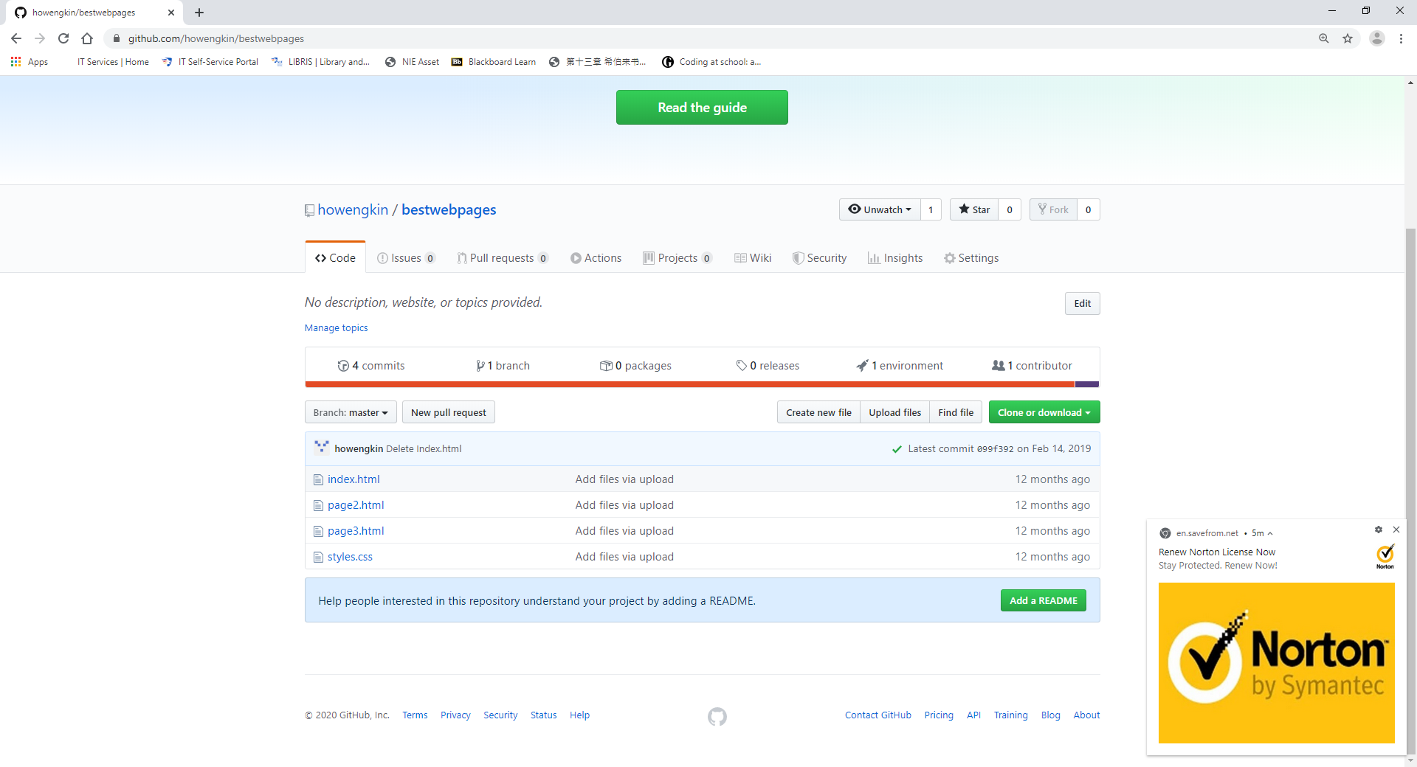
Uploading files

Slide 10
Uploading files
Click “Upload files”.
Select the files to be uploaded, amongst which the main landing html file must be called index.html.
Make sure none of the files, including *.jpeg/jpg, have uppercase and special characters in their file names.
After uploading all the files into the current repository, click “Commit”.

Slide 11
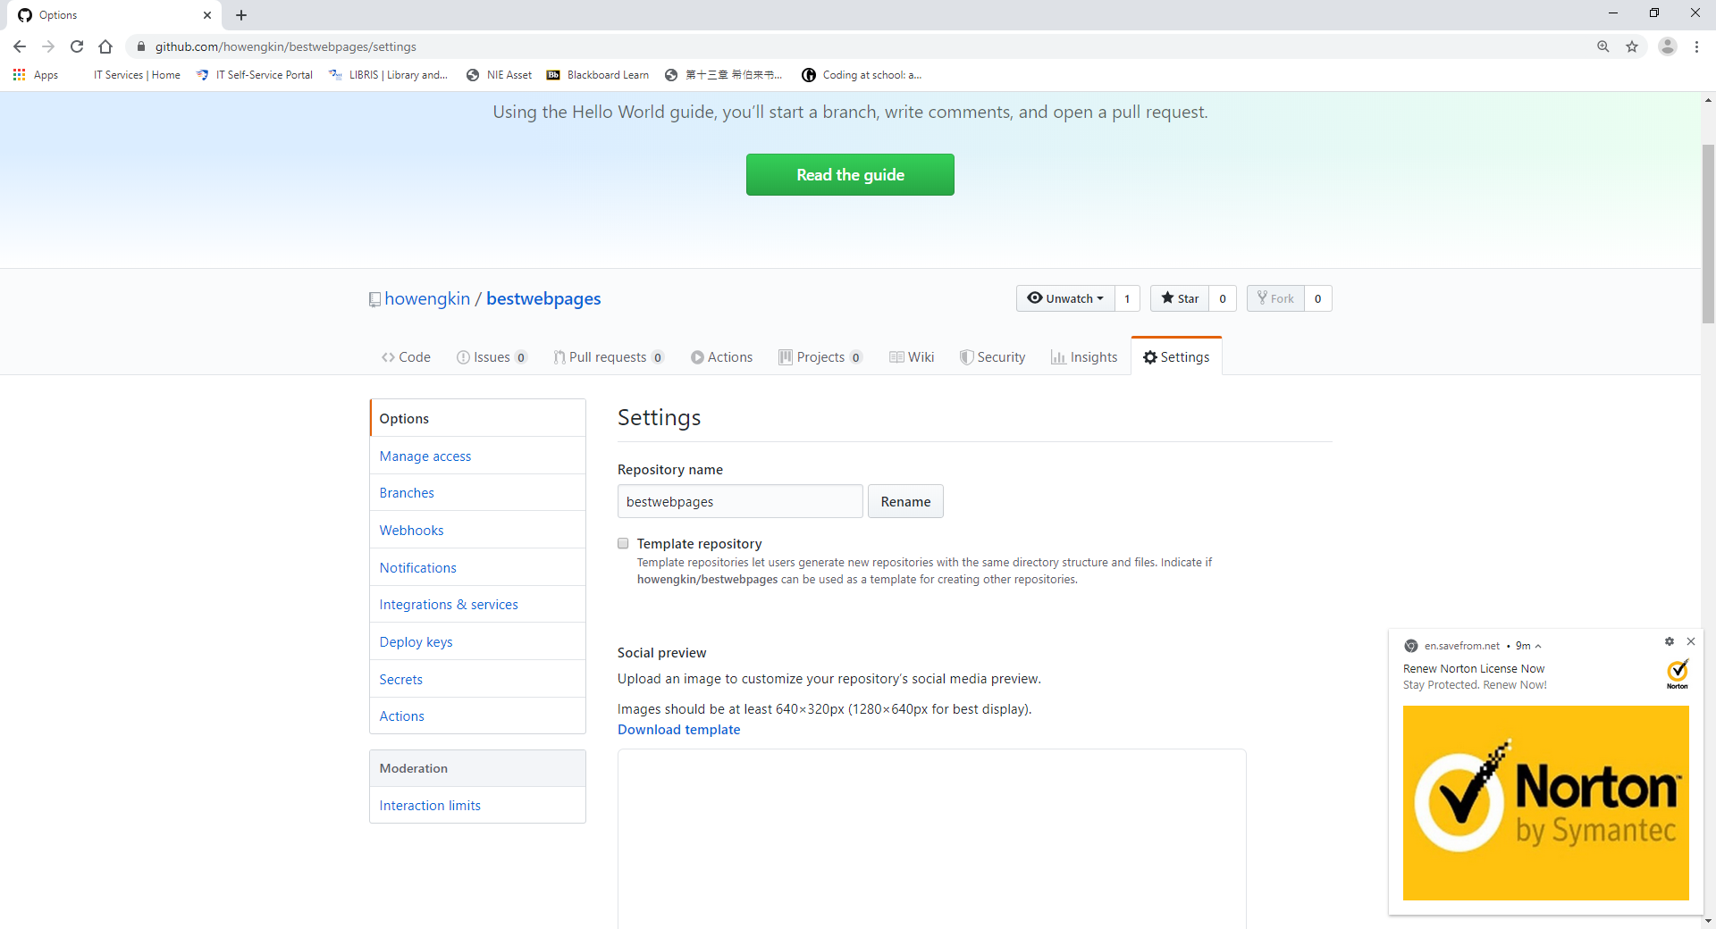
Settings

Slide 12
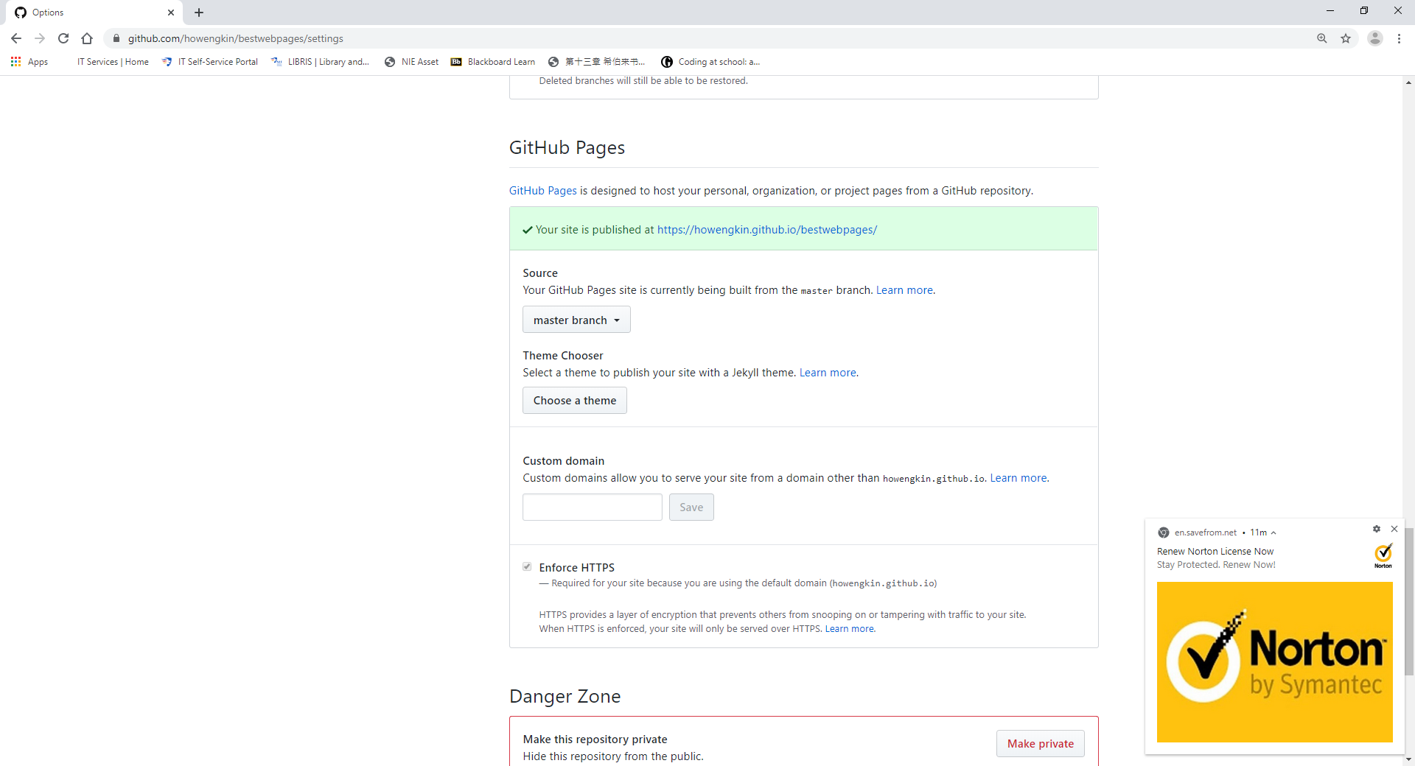
Settings: scroll down to Github Pages

Slide 13
Settings: select “Master branch” under source

Slide 14
Settings: scroll down to Github Pages for url

Slide 15
The all-important link
The url under Github Pages will provide an open access hyperlink to all who are given it, i.e., you can copy and paste in an email, and the reader of the email can click the link and visit the website.

